Slide 1



Measuring Compliance with the California Consumer Privacy Act Over Space and Time
Van Tran^{1,} Aarushi Mehrotra¹, Marshini Chetty¹,
Nick Feamster¹, Jens Frankenreiter ², Lior Strahilevitz¹
1
2
Notes:
Logo smaller

Slide 2


Where Does Our Data Go?
Third-party
Third-party
Third-party
Private personal
information
Notes:
Every day, we spend hours browsing on the internet. That also means that the websites and apps that we use can collect vast amount of our private personal data including our identifier information and other information such as browsing history, opinions and preferences.
Often, the data collected does not just stay within the website or app but are often sold or shared with third parties to generate profits for these businesses. This practice could be done without explicit use consent.

Slide 3


Potential harms to consumers
Targeted advertising
Consumer profiling
Manipulation & Influence
Data breaches & Identity theft

Slide 4
The California Consumer Privacy Act
Went into effect in January 2020
Consists of 6 important privacy rights, including the right to opt-out of sale of personal information
Strengthened by the California Privacy Rights Act (CPRA) which went into effect in January 2023

Slide 5
Who is subject to the CCPA?
Any for-profit entities that do business in California, and satisfy at least one of the following thresholds:
1. Have annual gross revenues >$25 million
2. Buy or sell personal information of >= 50,000 Californian consumers
3. >50% of their annual revenue from selling consumer personal data
2. Buy or sell or Share personal information of >= 100,000 Californian consumers

Slide 6

Opt-out Methods
Before CPRA:
Do Not Sell My Personal Information
After CPRA (any of the three):
Do Not Sell or Share My Personal Information
Limit the Use of My Sensitive Personal Information
Your Privacy Choices
Frictionless opt-out preference signals (GPC).
Notes:
Before the CPRA, websites are required to implement the link titled Do not Sell My Personal Information at the header of footer of the webpage.
However, after the CPRA went into effect, websites should no longer use that link but instead, they have few alternative options to implement the opt-out method.
First, they can implement a link titled Do not sell or share my personal information link at the header of footer of the website
And because CPRA differentiate sensitive personal information from the general personal information, if businesses processes consumer’s sensitive personal information, they are required to implement a “Limit the use of my sensitive personal information” link besides the “Do not sell or share my personal information” link on the website.
Alternatively, they can also implement the alternative opt-out links such as “Your Privacy Choices” link with the opt-out icon next to it in lieu of providing the two links mentioned above
Finally, they can also choose to implement frictionless opt-out preferences signals.
Frictionless opt-out preference signals is a signals that the users can sent directly from the browser to the website that they are visiting to communicate about their opt-out preferences. Depending on the browser they are using,
Users may be required to do different steps to invoke opt-out preferences signals. For examples, for private browsers like Duckduckgo, users are only required to visit the website on Duckduckgo and the browser will sent the opt-out prederences to the websites. On the other hand, Firefox requires users to modify the browser Privacy Settings to invoke Opt-out preferences signals. Google Chrome require users to install GPC extensions in order to invoke GPC.
In this study, we focus on measuring the Do not sell or share my personal information link and the privacy choices link which we call “the opt-out link” which is the more common opt-out methods implemented by websites.

Slide 7
Research Questions
RQ1: How does the implementation of the CCPA’s opt-out requirements change over time?
RQ2: Are websites complying with the CCPA’s opt-out requirements?
RQ3: Do the businesses that implement the opt-out link for the sale and sharing of personal data also let non-Californian consumers opt-out?
RQ4: Do businesses that fail to provide opt-out links on their home page offer other opt-out methods, or are they not subject to CCPA?
RQ1: How does the implementation of the CCPA’s opt-out requirements change over time?
RQ2: Are websites complying with the CCPA’s opt-out requirements?
RQ3: Do the businesses that implement the opt-out link for the sale and sharing of personal data also let non-Californian consumers opt-out?
RQ4: Do businesses that fail to provide opt-out links on their home page offer other opt-out methods, or are they not subject to CCPA?
Notes:
To the best of our knowledge, our work is one of the first that tries to measure the impact of CPRA on the behaviors of businesses. Understanding whether CPRA has an impact on the
Businesses’ behaviors can help policy makers and law enforcement make better decision in how to protect consumers’ privacy.
In this study, we focus on 4 research questions.
The first question we want to focus is how has the implementation of the CCPA’s opt out requirements change over time. This question is interesting because the CPRA revised the criteria of who is subject to the CCPA, as mention above. So we would like to see whether this has impact on the number of websites implementing the opt-out link.
The next research question is are websites complying with CCPA’s opt-out requirements. Although the appearance of the opt-out link cannot say exactly whether websites are fully meeting CCPA’s opt-out requirements. However, because of the difference between how CCPA and CPRA requires the opt-out link to be, we want to see whether websites are attempting to comply with CPRA’s requirements by modifying, at the very least, the appearance of the opt-out link.
Next, the questions of whether non-California can enjoy the opt-out requests as California residents is very interesting from the policy-makers perspectives. For example, if websites tend to extent the opt-out rights even to those states where they don’t have to, then, it might be more beneficial for consumers to pass state-specific privacy laws that are more stringent, compared to a national privacy laws that is less. As such, we ask ourselves the question. Do the businesses that implemenmt the opt-out link for the sale and sharing of personal data also let non-Californian consumers opt-out.
Last but not least, we want to know if businesses that fail to provide opt-out links on their home page offer other opt-out methods, or are they not subject to CCPA.
Next, are the implementations of the opt-out links meeting the requirements of the CCPA.
Next, although the CCPA only requires businesses to offer opt-out rights to California consumers, we are interested to know whether extending the opt-out rights to non-California consumers, in other words, are non-California consumers benefiting from the CCPA.
Last but not least, what are the reasons for the absence of the opt-out links.
Due to the interest of time, we will not cover RQ2 in this talk.
Explain the importance of each research question

Slide 8
Outline
A. Vantage Point & Dataset Selection
B. Methodology
C. Findings
D. Limitations

Slide 9

A. Vantage Point & Dataset Selection
CA
1/1/2020
VA
1/1/2023
CO
7/1/2023
UT
12/31/2023
IL
No state-specific privacy laws
Notes:
We conduct our measurements from 5 vantage points.
CA has the CCPA went into effect in January 1, 2020.
VA, CO, UT also have state-specific privacy laws resembling the CCPA but they went into at different dates. In addition, there are also some differences between these states’ privacy laws and the CCPA. For example unlike the CCPA which specify exactly how businesses should implement the opt-out method, these laws only requires business to disclose and offer consumer a method to opt-out without specifying what these opt-out methods should be. This may allow businesses to offer consumers opt-out methods that are difficult to execute.
Last but not least, We also include IL, a state which does not have a state-specific privacy laws to serve as a contrast vantage point to see the spillover effects of CCPA on states that the websites do not have to offer any opt-out methods at all.

Slide 10

A. Vantage Point & Dataset Selection
Measured twice per month from 1/2023-7/2023.
1016 unique websites.
Notes:
For each states mentioned above, we measured twice per month for each state form January 2023 to the end of July 2023.
Our dataset consists of 1016 unique websites, taken from a popular website ranking website. We select top websites from 80 categories to create a diverse set of websites.

Slide 11
B. Methodology
CCPA’s requirements
Manual inspection
List of keywords
Notes:
From the requirements of the CCPA, we first came up with the list of keywords to identify the opt-out link.
To ensure that we do not miss out on opt-out links just because they use different wordings, we also did a manual check in January 2023 and augment the list of keywords with opt-out wordings that we found.

Slide 12


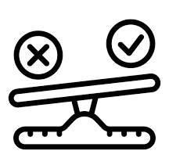


B. Methodology
Search in
page source
Obtain
keywords
Render
website
Compare
keywords
Search directly
on website
Obtain
keywords
Notes:
Now, we measure presence of the opt-out link over time based on the list of keywords.
we first render each website using Selenium library.
Next we search in the page source to see whether any elements with tag names such as anchor, span, button and so on contains the keywords.
One limitation of this approach is that there are websites that implement the opt-out link as a dynamic element.
As such, sometimes, the opt-out link can’t be found in the page source. Examples for this will be shown in the next slide.
In addition, we also search directly on the rendered website using the search bar to see if there is results that match the keywords we are looking for.
For each keyword searched using the search bar, we capture the screenshot of the page, crop out the image of the search bar and convert the image to text using Python’s ORC library.
From this text of the search bar, we can infer whether keyword is present.
After finding the keywords found from 2 approaches, we then compare them to see if they agree and will manually check if they disagree.

Slide 13
Verify methods
False Positive cases
False Negative cases
We do not sell OEM (Original Equipment Manufacturer) cartridges on this website.
My Privacy and Ad Choices
Your California Privacy Rights
… your settings and privacy choices, and to support our marketing and sales efforts.
Notes:
To verify the success of our method, we randomly choose a date to verify our method. After manually checking each website from CA vantage point on that date, we compare against the results against those obtained from our method.
Our results yieled 2 false positive case and 2 false negative cases.

Slide 14
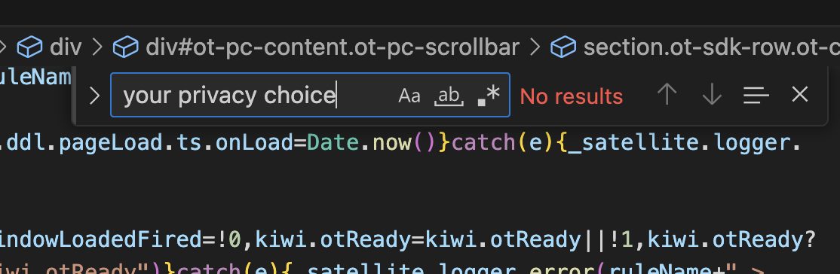
Verify methods
14 cases present in screenshot but not page source
2 cases present in page source but not screenshot
Notes:
In addition, we also
2 case where page source have but screenshot don’t have
14 case where screenshot have but page source don’t have

Slide 15
Outline
A. Dataset and Vantage Point Selection
B. Methodology
C. Findings
D. Limitations
Notes:
To answer these research questions, we will first talk about ….

Slide 16
Research Questions
RQ1: How does the implementation of the CCPA’s opt-out requirements change over time?
RQ2: Are websites complying with the CCPA’s opt-out requirements?
RQ3: Do the businesses that implement the opt-out link for the sale and sharing of personal data also let non-Californian consumers opt-out?
RQ4: Do businesses that fail to provide opt-out links on their home page offer other opt-out methods, or are they not subjected to CCPA?
Notes:
We are really interested to whether and how much impact these privacy laws have on the websites. As such, we ask ourselves these questions,
Firstly, how has the implementation of the CCPA’s opt out requirements change over time, especially after the CPRA went into effect.
Next, are the implementations of the opt-out links meeting the requirements of the CCPA.
Next, although the CCPA only requires businesses to offer opt-out rights to California consumers, we are interested to know whether extending the opt-out rights to non-California consumers, in other words, are non-California consumers benefiting from the CCPA.
Last but not least, what are the reasons for the absence of the opt-out links.
Due to the interest of time, we will not cover RQ2 in this talk.

Slide 17
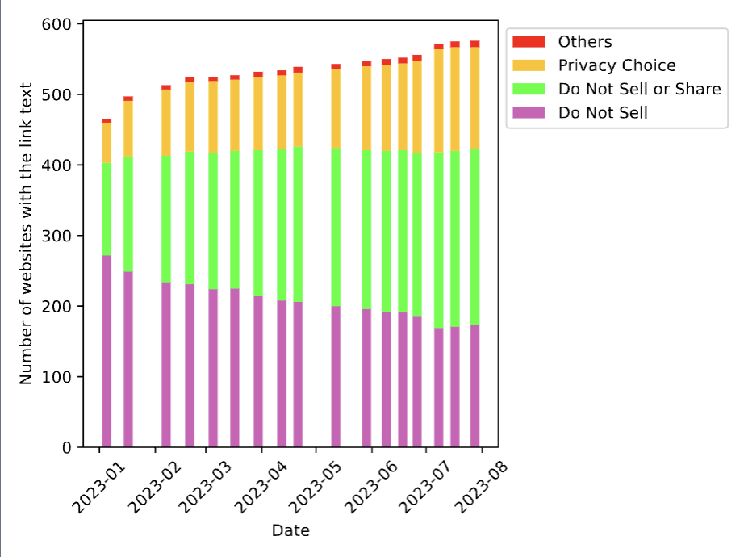
RQ1: How does the implementation of the CCPA’s opt-out requirements change over time?
Number of websites where the opt out link is seen at least once by each measurement date, measured from CA vantage point, N=1016.
Websites are increasingly but not fully complying with CCPA’s requirements.
Notes:
For the first questions about how the implementation of the opt-out link changes over time, we see that
Firstly, the number of websites where the opt-out link has been seen increases over time, and the increase is more pronounced around January 2023 compared to other months.
We also see a decrease in the number of websites using the outdated terminology “Do not sell my personal information link” and an increase in the number of websites with CCPA compliant wordings such as Do not sell or share my personal information or Privacy Choices.
This means that websites are increasingly but not fully complying with CCPA’s opt-out requirements.

Slide 18
Research Questions
RQ1: How does the implementation of the CCPA’s opt-out requirements change over time?
RQ2: Are websites complying with the CCPA’s opt-out requirements?
RQ3: Do the businesses that implement the opt-out link for the sale and sharing of personal data also let non-Californian consumers opt-out?
RQ4: Do businesses that fail to provide opt-out links on their home page offer other opt-out methods, or are they not subject to CCPA?
Notes:
Now let’s move on to our second research question, are websites complying with the CCPA’s opt-out requirements? Note that checking whether websites are complying with the opt-out requirements involves several steps, including checking whether the opt-out link is present, and if the opt-out link is present, do they meet the requirements for how it should look like and last but not least, is the opt-out link really functional and do the opt-out process meet the requirements for how they should be like.
However, checking for whether the opt-out link is functional and meet the requirements of CCPA is very challenging, especially because websites can implement their opt-out process very differently. As such,
In this study, we focus on checking whether the opt-out link is present and whether it appearance meet the requirements of CCPA. We believe that this is the first step towards checking for other requirements because if they fail to meet these requirements and if websites fail to comply with this first step, then it is unlikely they can fulfil other requirements.

Slide 19
Opt-out Methods
Before CPRA:
Do Not Sell My Personal Information
After CPRA (any of the three):
Do Not Sell or Share My Personal Information
Limit the use of My personal information
Your Privacy Choices
Frictionless opt-out preference signals (GPC).
Notes:
As mentioned previously, the CCPA spell out clearly how the opt-out link should look like.
For example, opt-out link should be placed at the header or footer of the website. It should be titled Do Not sell or share my personal information or your privacy choices.
If they are titled your privacy choices, then it also needs an opt-out icon next to it.

Slide 20
Opt-out link present
(428)
RQ2: Are websites complying with the CCPA’s opt-out requirements?
Do Not Sell or Share
(Compliant)
(178)
Do Not Sell
(Non-compliant)
(141)
Others
(Non-compliant)
(1)
Privacy Choices
(Compliant)
(108)
Located at footer or header (Compliant)
(171)
Not at footer or header (Non-compliant)
(7)
~ 45% fail to comply fully with CPRA’s requirements
Opt-out icon absent (Non-compliant)
(46)
Opt-out icon present( Compliant)
(62)
Notes:
To check whether websites meet the requirements for the appearance of the opt-out link, we manually visit each website that has the opt-out link on July 10,2023 from CA vantage point and successfully access 428 of them. We see that by this date, 142 websites or over 30% of websites with the opt-out link still use the outdated wording Do not sell my personal information link or non-compliant wordings. A few websites using the Do not sell or my personal information wording fails to meet the requirements for the location of the opt-out link. And over 40% of websites that use the privacy chocies wording fail to implement the opt-out icon next to the opt-out link. Overall, 45% of websites implement the opt-out link fail to comply fully with CPRA’s requirements for the appearance of the opt-out link.

Slide 21
Research Questions
RQ1: How does the implementation of the CCPA’s opt-out requirements change over time?
RQ2: Are websites complying with the CCPA’s opt-out requirements?
RQ3: Do the businesses that implement the opt-out link for the sale and sharing of personal data also let non-Californian consumers opt-out?
RQ4: Do businesses that fail to provide opt-out links on their home page offer other opt-out methods, or are they not subject to CCPA?
Notes:
Next, we are also interested to know whether business that implement the opt-out link also let non-California consumers opt-out.
Again, checking whether non-California consumers involve several steps such as checking whether the opt-out link is present from non-CA vantage point, and if the opt-out link is present, whether non-CA can successfully opt-out just like a CA resident. This again, is a challenging task and therefore, we use the present of the opt-out link as potential indication that non-CA consumers can benefit from CCPA.

Slide 22
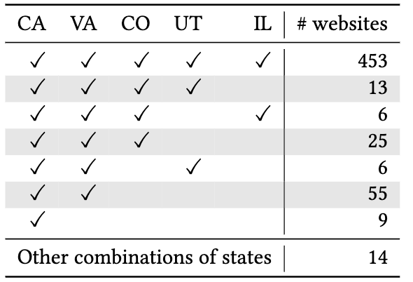
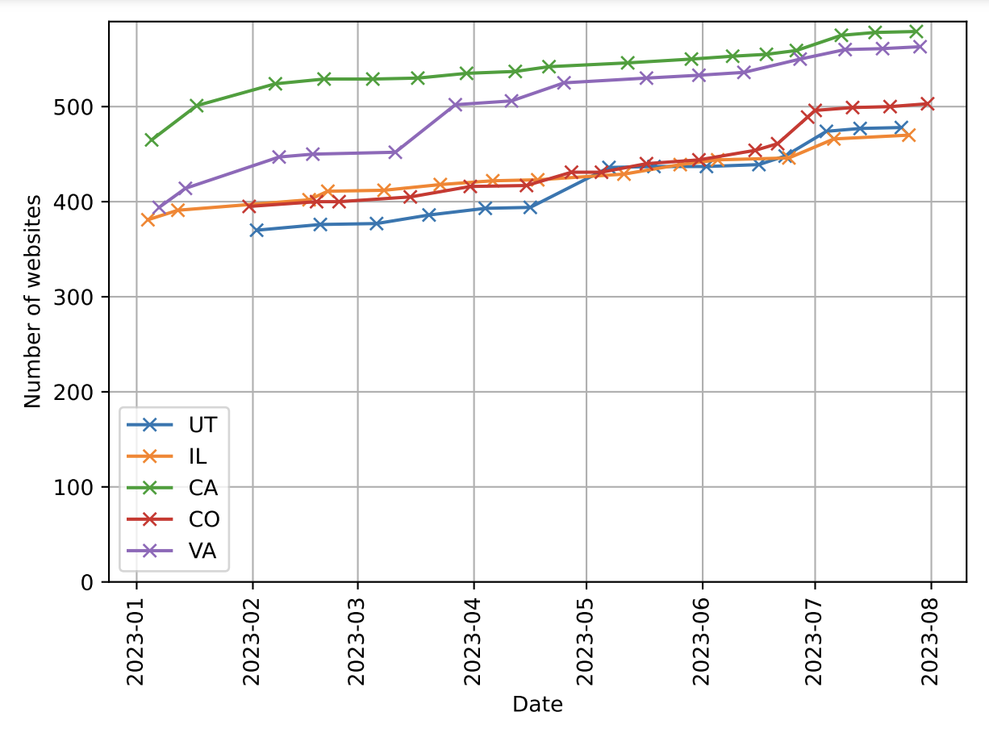
RQ3: Do the businesses that implement the opt-out link also let non-Californian consumers opt-out?
Number of websites where the opt-out link has been seen by each date at each state (N=1016 websites).
453 (78%) websites implement the opt-out link in CA also implement across all states.
CA’s privacy law in Jan 2020
VA’s privacy law
CO’s privacy law
UT’s privacy law in Dec 2023
Notes:
To see whether websites are extending the opt-out rights to non-California consumers, we plot the graph of the number of websites with the opt-out link seen by each date for each vantage point.
We see that the number of websites with the opt-out links increases for all states. CA always have the largest number of websites with the opt-out link, followed by VA. However, VA starts to catch up with CA arounf April 2023.
Next, CO and UT used to be slightly behind IL in the beginning months of 2023. However, from May onwards, CO now took the lead amongst 3 states with UT following behind it.
Now we look at each website closely to see which states they implement the opt-out links for. We found that the majority of these websites implement the opt-out link across all 5 states, including IL which does not have a state specific privacy law. Next, about 10% of websites that implement the opt-out links in CA only implement it in CA and VA only. Next, 25 websites that implement the opt-out links only in states where the privacy laws went into effect, 13 websites that implement in states that have privacy laws.
Although we have not looked closely at whether the presence of opt-out link in non-CA states really mean that non-CA residents can successfully opt-out, it still suggests that non-CA potentially benefit from the spill-over effects of the CCPA.

Slide 23
Research Questions
RQ1: How does the implementation of the CCPA’s opt-out requirements change over time?
RQ2: Are websites complying with the CCPA’s opt-out requirements?
RQ3: Do the businesses that implement the opt-out link for the sale and sharing of personal data also let non-Californian consumers opt-out?
RQ4: Do businesses that fail to provide opt-out links on their home page offer other opt-out methods, or are they not subject to CCPA?

Slide 24
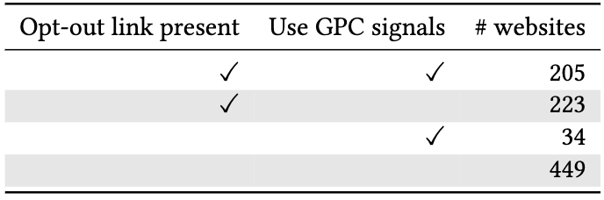

Frictionless opt-out preference signals
Front page
Opt-out page (after clicking on the opt-out link)
Privacy Policy
Notes:
As mentioned in the beginning of the talk, besides offering an opt-out link, websites can choose to honor opt-out preference signals in a frictionless manner. As such, we want to investigate how often is the opt-out preference signals implemented and which websites tend to implement the opt-out preference signals.
One thing to remember about the opt-out preference signals is that, although websites are not required to notify users whether the opt-out preference signals sent by the user is honored, they are required to mention that websites choose to respect opt-out preference signals in their privacy policy. As such, in this study, we will treat any mentioning of the GPC signals by the websites as an attempt made by the website to respect GPC signals.
In order to do this, we manually browse each website using DuckDuckGo browser. This browser automatically sent an opt-out preference signals request to every website that we visit using browser. We take note of every notification and mentioning about the GPC signals when we visit the front page, opt-out page and privacy policy of the website.
Because this study is done manually and time consuming, we only do it once on July, 10, 2023 , at the end of our measurement period where the CPRA clearly took effect and became enforceable.
We successfully visited 911 websites from CA vantage point, opt-out preference signals are not as popular as opt-out links. We can see that the number of websites that implement both opt-out links and GPC signals is about 23%, only opt-out link is 25%, and only GPC is about 4%. This shows that, there is only a small percentage of websites that implement opt-out links in replacement to opt-out links.

Slide 25
Who is subject to CCPA?
Any for-profit entities that do business in California, and satisfy at least one of the following thresholds:
1. Have annual gross revenues >$25 million
2. Buy or sell or Share personal information of >= 100,000 Californian consumers
3. >50% of their annual revenue from selling consumer personal data

Slide 26
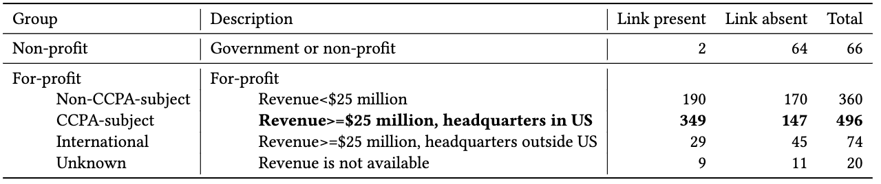
RQ4: Do businesses that fail to provide opt-out links on their home page offer other opt-out methods, or are they not subject to CCPA?
147 (30%) websites that are likely subject to CCPA still do not implement the opt-out link.
Presence of the opt-out link in each category of websites
Notes:
In order to answer that question, we first categorize websites based on the likelihood that they are subject to CCPA. Just to refresh our memory, websites subject to CCPA are for-profit businesses that conduct business in CA, and satisfy at least one of the three criteria such as having annual gross revenue of at least 25 million dollars, buys or sells personal information of >= 100,000 California consumers or derives at least 50% of annuak revenue from selling consumer’s personal information. However, not all of these information are available to the public, for example information such as number of California consumers or percentage of revenue derived from selling consumer’s personal information are often not publicly available. As such, we based on categorization on other information such as whether the business is for profit or not, their annual revenue and head quarter locations to decide whether websites are likely subject to CCPA.
We found out that amongst the websites that are likely CCPA-subject, 147 still do not implement the opt-out link and we want to investigate the reason for this.

Slide 27
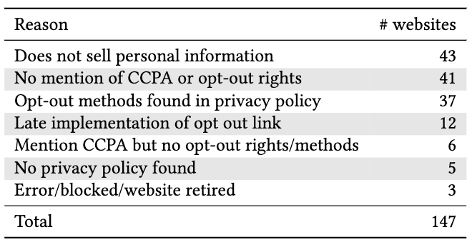
Reasons for Potential Non-Compliance
Reasons for failure to comply to the CCPA are varied and ambiguous.
Notes:
We want to investigate what could be the potential non-compliance amongst this CCPA-subject websites. As such we manually look into their privacy policy pages.
43 websites claim that they do not sell personal information. Note that if they share personal information, then that means they might still be subject to CCPA
41 does not mention CCPA or opt-out rights at all.
43 offer some opt-out methods such as opt-out form, sending email or making a call and so on.
Overall we find that the reasons for failure to comply with the CCPA are varied and still have a lot of ambiguities.

Slide 28
D. Limitations
Presence of opt-out link does not mean it is functional/compliant to CCPA.
Presence of opt-out link at non-CA vantage point does not mean non-CA residents can exercise opt-out rights.
Notes:
Hi everyone, my name is Van Tran. Today, I am going to present our work: Measuring Compliance with the California Consumer Privacy Act over Space and Time.
Every day, we spend hours browsing on the internet. This also means that the websites and apps are collecting vast amount of our private personal data including our identifier information ,browsing history, opinions and preferences.
Often, the data collected does not just stay within the website but can get sold or shared with third parties to generate more profits for these businesses.
And this gives rise to many potential harms to consumers including targeted advertising, consumer profiling, manipulation and influence, data breaches and identity theft.
The California Consumer Privacy Act or CCPA for short was introduced in 2018. The goal of the act is to give California consumers more control over their personal information. The act went into effect in 2020, consists of 6 important privacy rights, including the right to opt-out of sale of personal information.
The California Privacy Rights Act or CPRA for short, aims to strengthen the CCPA and it went into effect in January 2023. The CPRA made several amendments to the CCPA, these include it extends the right to opt-out to include not just sale but also sharing of personal information. It also revise the criteria of who is subject to the CCPA. It also differentiate sensitive personal information as a separate category of the general personal information.
In terms of the opt-out methods, the old CCPA requires firms to offer a Do not Sell My Personal Information link in their websites. However, this is no longer acceptable by the CPRA,
Instead, firms have these 3 options to implement the opt-out methods.They can either implement the Do not sell or share my personal information link located at the top or bottom of their websites. They can also provide alternative opt-out link such as
Privacy Choices link with the opt-out icon next to it. In this study, we are going to use the "opt-out link" to refer to both the Do not sell or share my personal information link and Privacy Choices link and this is also the focus of this study.
Lastly, websites can also choose to respect opt-out preference signals. However, they have to mention in the privacy policy that they respect opt-out preference signals.
We are really interested to know whether these privacy laws have any effect on the behaviors of the websites. As such, we come up with these 4 research questions. Firstly, how does the implementation of the CCPA’s opt out requirements change over time? Next, are websites complying with the CCPA's opt-out requirements? Next, do the businesses that implement the opt-out link for the sale and sharing of personal data also let non-California consumers opt-out? Last but not least, do businesses that fail to provide opt-out links on their home page offer other opt-out methods, or are they not subject to CCPA?
Due to the interest of time, we will not cover RQ2 in this talk.
So, to answer these research questions, this is the outline for today's talk. We will first cover dataset and vantage point selection, followed by methodology, findings, and lastly limitations.
We choose to conduct our measurements from 5 states. Virginia, Colorado and Utah are the states that also have their privacy laws resembling the CCPA. These states have their privacy laws went into effect at different timings and also have some differences between them. Illinois does not have any state specific privacy laws therefore, it is used as a contrast vantage point for us to see the spillover effects of CCPA on those that do not have privacy laws. We conduct our measurement on 1016 unique websites from the start January 2023 to the end of July, 2023. For each state, we measured twice per month.
Now let's move on to our methodology.
Before conducting our measurement, we first come up with a list of keywords to identify the opt-out link. Luckily, the CCPA has spelled out the magic keywords to identify the opt-out link such as privacy choices or do not sell or share my personal information. We also do a manual check on the website to see whether these keywords are sufficient and add on several keywords that are not included i the CCPA.
Next, for each website, we first render them using Selenium.
Next we use 2 approaches to search for the opt-out link. We first search in the page source to see whether any elements such as "anchor", "button" and "span" that contain the keywords that we are looking for. We also search directly on the website using the search bar. We then compare the keywords obtained from these 2 approaches together and if they disagree and we will manually check.
Now let's move on to our findings.
For the first question of how does the implementation of the CCPA's opt-out requirements change over time, we plot the graph of the number of websites that implement the opt-out link by each measurement date. We see that the number of websites implemented the opt-out link increases over time, and this increase is slightly steeper around January 2023 compared to other months.
We also see that there are a decrease in the number of websites that use the outdated wording “Do not sell my personal information” and an increase in the number of websites that use CCPA compliant wordings such as Privacy Choices or Do not sell or share my personal information .
Overall, we see that websites are increasingly but not fully complying with CCPA’s requirements yet.
For the next research question, "Do the businesses that implement the opt-out link for the sale and sharing of personal data also let non-California consumers opt-out?, we also plot a similar graph for these 5 states. We found that across these 5 states, the number of websites implementing the opt-out link increase over time. CA is always the leader in terms of the number of websites with the opt-out link, followed by VA although the gap between VA and CA starts to close up around April 2023.
Interestingly, we also found that IL used to slightly lead UT and CO especially in the beginning months of 2023, however, as we move closer to May and June 2023, CO now took the lead amongst 3 states followed by UT and finally IL. We looked at these websites further and we found out that 78% of websites that implement the opt-out links in CA also implement that across all of the examined states.
Now, let's move on to our last research question, Do businesses that fail to provide opt-out links on their home page offer other opt-out methods, or are they not subject to CCPA?
Let's first look at the question of who is subject to the CCPA. Firms subject to the CCPA are those for-profit entities that collect consumers' personal data, which does business in California and satisfy at least one of the following thresholds.
First, has annual gross revenue exceeding 25 million dollars. Second, possesses the personal information of at least 100,000 California consumers and lastly, derives at least 50 percent of of their annual revenue from selling consumers' personal data.
As you might have guessed, information such as the number of California consumers or how much of the annual revenue are derived from selling consumer personal data are often not readily publicly available.
As such, we try our best to use other information such as whether the business is for-profit or not, where are their headquarters located and their annual gross revenues to categorize these websites into whether they are subject to CCPA.
Interestingly, we found that there are a significant number of websites that still implement the opt-out link although they might not be subject to the CCPA. These include non-profit websites, or for-profit websites with annual revenue of less than 25 million dollars. On the flip side, we saw that 30% of websites that are likely CCPA-subject still do not implement the opt-out link.
And we are really. interested to see what can be the reasons for this potential non-compliance. We have looked closely at their privacy policy, and here is what we found.
43 websites claim that they do not sell consumers' personal information. Note that this might exclude them from being subject to the old CCPA but might not exclude them from the CPRA because the CPRA includes firms that sells or share personal information.
41 does not mention CCPA or opt-out rights at all.
In addition, 37 websites have their opt-out methods mentioned in their privacy policy and these opt-out methods might not might not be deemed as acceptable by the CCPA. For example,
they can embed the opt-out form in their privacy policy, or require consumers to give them a phone call or email to communicate about their opt-out rights.
So Overall we see that the reasons for failure to comply with the CCPA are varied and ambiguous and requires more investigation.
We acknowledge that our study can suffer from several limitations. For example, the presence of opt-out link does not mean it is functional/compliant to CCPA. In addition, the presence of opt-out link at non-CA vantage point does not mean non-CA residents can exercise opt-out rights.
In summary, our study sheds light on the following research questions. We found out that websites are increasingly but not fully complying with CCPA's requirements yet. We also found out that the majority of websites that implement the opt-out link in california also implement across all examined states. We also found that 30% of websites that are likely subject to CCPA still do not implement the opt-out link and the reasons for these failures are varied and ambiguous.
Thank you for your attention and if you have any questions, please contact me at tranv@uchicago.edu

Slide 29
Summary
Websites are increasingly but not fully complying with CCPA’s requirements.
RQ1: How does the implementation of the CCPA’s opt-out requirements change over time?
RQ2: Are websites complying with the CCPA opt-out requirements?
RQ3: Do the businesses that implement the opt-out link for the sale and sharing of personal data also let non-Californian consumers opt-out?
RQ4: Do businesses that fail to provide opt-out links on their home page offer other opt-out methods, or are they not subjected to CCPA?
45% fail to meet requirements for appearance of opt-out
453 (78%) websites implement the opt-out link in CA also implement across all states
147 (30%) websites that are likely subject to CCPA still do not implement the opt-out link.
Reasons for failure to comply to the CCPA are varied and ambiguous.
Questions?
tranv@uchicago.edu
University of Chicago
Notes:
We are really interested to whether and how much impact these privacy laws have on the websites. As such, we ask ourselves these questions,
Firstly, how has the implementation of the CCPA’s opt out requirements change over time, especially after the CPRA went into effect.
Next, are the implementations of the opt-out links meeting the requirements of the CCPA.
Next, although the CCPA only requires businesses to offer opt-out rights to California consumers, we are interested to know whether extending the opt-out rights to non-California consumers, in other words, are non-California consumers benefiting from the CCPA.
Last but not least, what are the reasons for the absence of the opt-out links.
Due to the interest of time, we will not cover RQ2 in this talk.
Finish this one.

Slide 30
Future direction
Automatically measure whether opt-out methods are functional? Contains dark patterns?
Measure whether the spill-over effects are ”real”?
How to measure whether websites are really fulfilling their promise?
Notes:
Define what spill-over is: effects of the law that is out of jusrisdiction
Prepare a few back up slides
How to coding
Prepare a few slides priminary results on what we have

Slide 31
Dark Patterns in the Opt-Out Process And Compliance with The California Consumer Privacy Act (CCPA)
Van Tran^{1,} Aarushi Mehrotra¹, Marshini Chetty¹,
Nick Feamster¹, Jens Frankenreiter ², Lior Strahilevitz¹
1
2

Slide 32
Summary Of Findings
RQ1: Can consumers successfully exercise their opt-out rights?
RQ2: What does it take for a consumer to submit an opt-out request? Do opt-out processes violate CCPA requirements?
RQ3: What types of dark patterns are used in the opt-out process? Are these dark patterns violating CCPA requirements or are they exploiting the loopholes that have not been addressed by the CCPA?
RQ4: What are the characteristics of the websites that employ dark patterns?
Nearly 30% of the attempted opt-out requests could not be submitted, did not succeed, or had unclear status updates
The opt-out process varies widely depending on website categories, opt-out control methods, and third-party platforms handling the opt-out process on behalf of the websites. Some sites allow submission with just a few clicks, while others require a lengthy process and significant personal information.
Multiple types of dark patterns are found in the opt-out process. Although some dark patterns are clearly prohibited by the CCPA, others are not explicitly addressed by the CCPA.
Most websites implement at least one type of dark pattern. Sites with different opt-out control methods and third-party platforms tend to exhibit different types of dark patterns.

Slide 33
The California Consumer Privacy Act (CCPA)
Enacted in 2018, is a significant stride in US consumer privacy protection law
The right to opt-out of sale/sharing is a cornerstone provision
CCPA-subject are required to provide consumers with a method to opt-out
However, businesses often implement dark patterns-which are manipulative user interfaces designed to trick, deceive or confuse users into taking actions that benefit businesses rather than the consumer
This make it difficult for consumers to opt-out

Slide 34
The California Privacy Right Acts (CPRA)
Went into effect in January 2021
Introduce additional clarifications on opt-out requirements and explicitly prohibit dark patterns
The first US law to explicitly ban dark patterns
Notes:
However, questions remain about the law’s effectiveness in preventing websites from using these tactics.
Since the CCPA serves
as the overarching statutory framework encompassing both the CCPA and CPRA, we will use the term "CCPA" to refer
to the comprehensive set of privacy regulations, including opt-out requirements.

Slide 35
CCPA Opt-Out Requirements
“at minimum, allow consumers to submit requests to opt-out of sale/sharing through an opt-out preference signal and at least one of the following methods: an interactive form accessible via the ’Do Not Sell or Share My Personal Information’ link, the Alternative Opt-out link, or the business’s privacy policy if the business processes an opt-out preference signal in a frictionless manner”
Notes:
To implement the opt-out right, businesses that are subject to the CCPA that collect personal information from
consumers online shall, "at minimum, allow consumers to submit requests to opt-out of sale/sharing through an opt-out
preference signal and at least one of the following methods: an interactive form accessible via the ’Do Not Sell or Share
My Personal Information’ link, the Alternative Opt-out link, or the business’s privacy policy if the business processes an
opt-out preference signal in a frictionless manner”.
In this study, we will use the term “opt-out link” to refer to the opt-out method via the Do not sell or share my personal information link and the alternative opt-out link .
Previous studies have noted that the opt-out process via the
opt-out link is often burdensome [3] and that websites more frequently implement the opt-out link than frictionless
opt-out preference signals. Therefore, this study focuses on the opt-out process using the opt-out link.

Slide 36
Research Questions
1. Can consumers successfully exercise their opt-out rights?
2. What does it take for a consumer to submit an opt-out request?
3. What types of dark patterns are used in the opt-out process? Are these dark patterns violating CCPA requirements or are they exploiting the loopholes that have not been addressed by the CCPA?
4. What are the characteristics of the websites that employ dark patterns?
Notes:
Specifically, we

Slide 37
Outline
Dataset selection
Method
Findings
Opt-out process
Dark patterns
Discussion
Summary

Slide 38
Dataset Selection
Stratified sampling to sample websites
(1,000 websites)
Identify websites with opt-out link
(542 websites)
Select those likely subject to CCPA
(330 websites)

Slide 39



Method
OPT-OUT METRICS & DARK PATTERNS TAXONOMY DEVELOPMENT
DATA COLLECTION & LABELLING
FOLLOW-UP PROCESS
Notes:
For methodology, we explain how to choose the dataset to study
Then we describe how we come up with metrics to describe the opt-out process and dark patterns present in the opt-out process
Next, we describe the data collection and labelling process, followed by how we follow-up with the opt-out process

Slide 40
Opt-Out Metrics
Number of clicks
Personal information required
Opt-out control methods
Notes:
In January 2024, We first conduct a pilot study on 100 websites randomly sampled from the 330 websites to study to help us develop
metrics to characterize opt-out process and dark patterns.
Browser opt-out: After consumers click on the opt-out link, they can select certain opt-out options—such as
toggling off data sharing or the sale of personal information—without needing to provide any personal details.
We call this control method "browser opt-out" since it is likely to use a browser-based method (not personal
details) to identify users.
• Opt-out form: Consumers must fill out an opt-out form that requires them to provide personal information, such
as their name, email address, phone number, or mailing address. This process typically involves multiple steps,
including submitting the form and possibly confirming the request via email or other means.
• Both browser opt-out & opt-out form (Both control methods): In this scenario, consumers must use browser opt-out
in addition to completing an opt-out form where they have to provide personal information

Slide 41
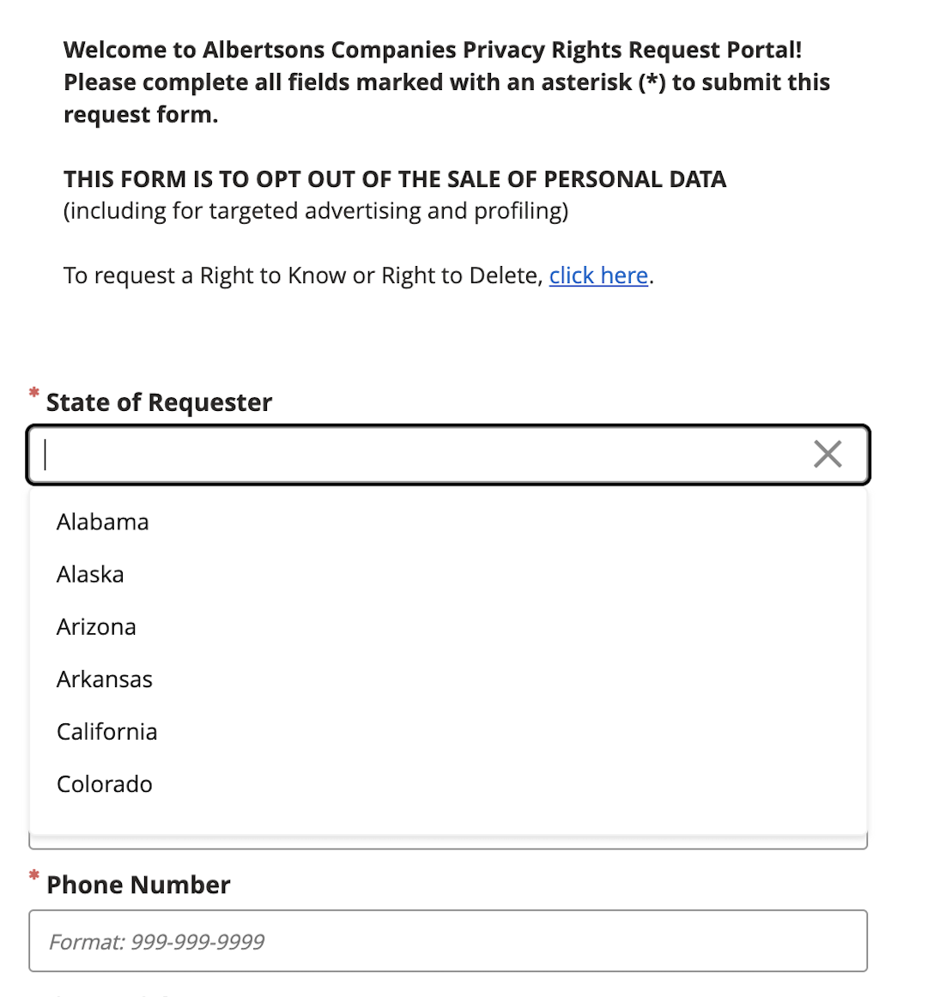
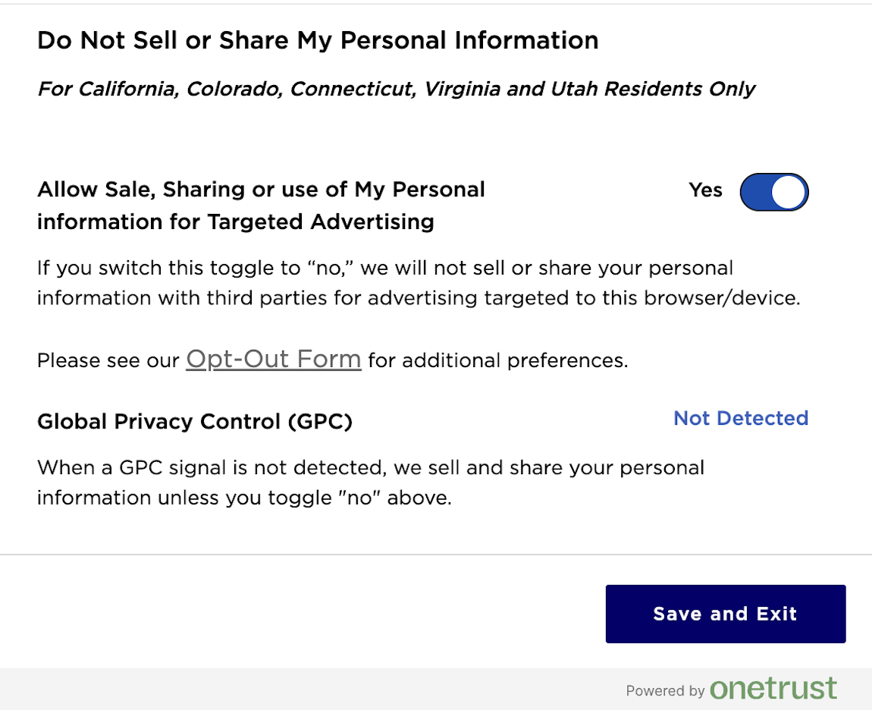
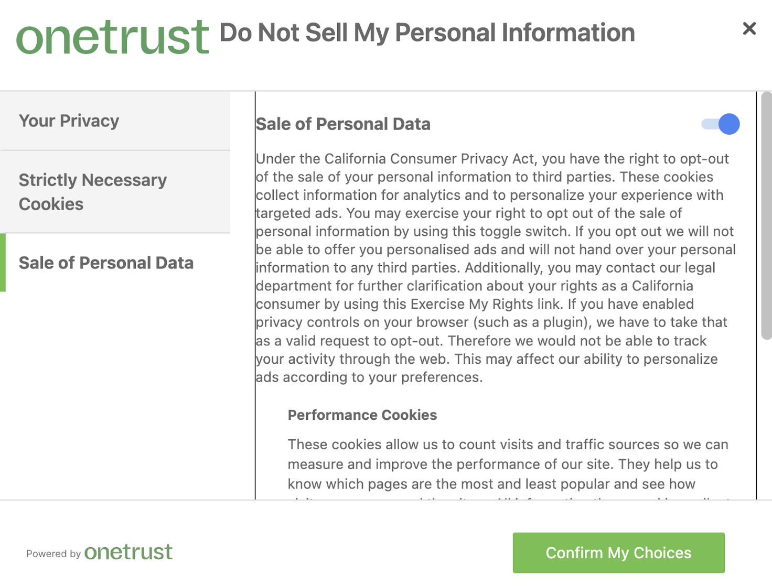
Opt-Out Control Methods
Browser opt-out
Opt-out form
Both control methods

Slide 42
Dark Patterns Taxonomy Development
Leverage existing dark pattern taxonomies
Our observations of possible dark patterns during the pilot study
(Details about dark patterns found will be explained in the findings)

Slide 43
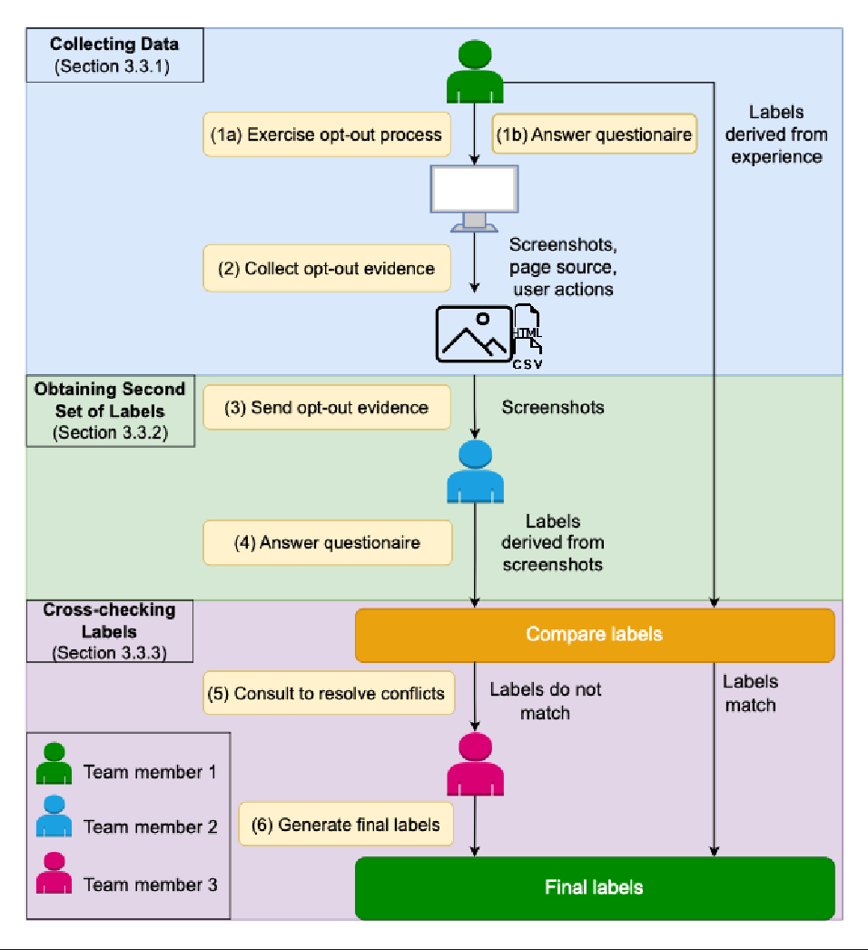
Data Collection & Labelling Process

Slide 44
Follow-Up Process
Track and follow-up with the opt-out process for two months after the request is submitted
Each website is assigned a unique identifier number
Summarize the purpose of email and what action is required

Slide 45
Findings

Slide 46
RQ1: Can Consumers Successfully Exercise Their Opt-Out Rights?

Slide 47
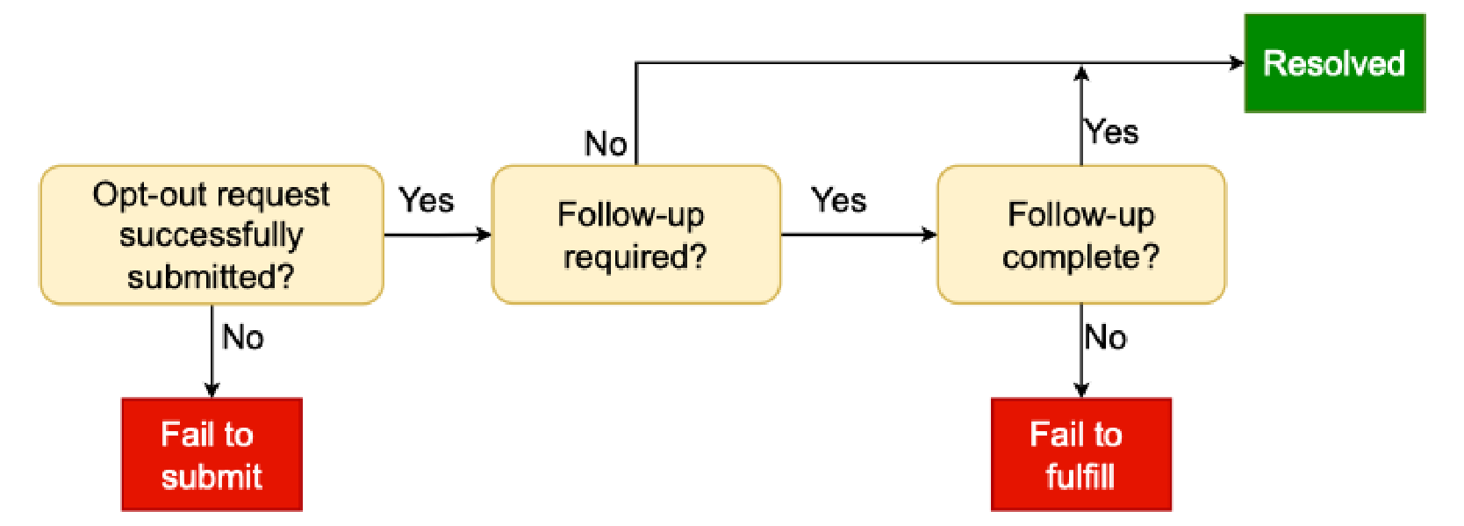
Categorizing opt-out request outcome

Slide 48
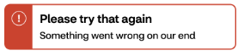
Opt-Out Request Outcomes
“You’re almost done. To complete your opt out, email DataPriacyOfficer@urbn.com or call (888) 708-0525 and give us the email address or addresses you wish to opt out.”
Failure to submit (37 websites)
Malfunctioning opt-out page (13 websites)
Require offline opt-out steps (10 websites)
Instructions only (8 websites)

Slide 49
Opt-Out Request Outcomes
”Thank you for your submission”
Failure to fulfill (48 websites)
Ambiguous status (35 websites)
Outstanding follow-up actions (7 websites)
Incomplete (6 websites)
“To ensure the highest possible security for your account, we need to verify some information. ..high school name, test name, ...”

Slide 50
Opt-Out Request Outcomes
Resolved (245 websites)
Confirmed to be successful (193 websites)
Non-matching profile (51 websites)

Slide 51
RQ2: What Does It Take For A Consumer To Submit An Opt-Out Request?

Slide 52
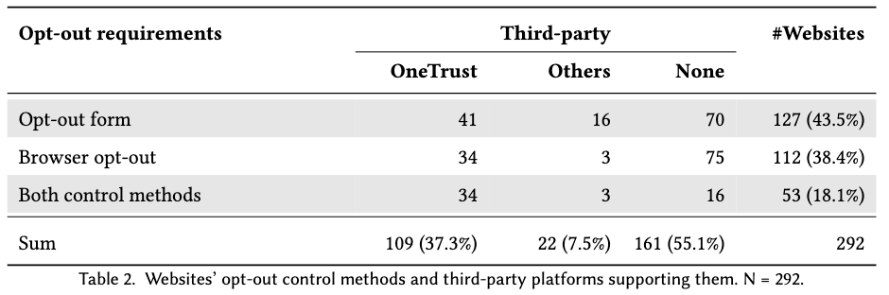
Opt-Out Control Methods

Slide 53
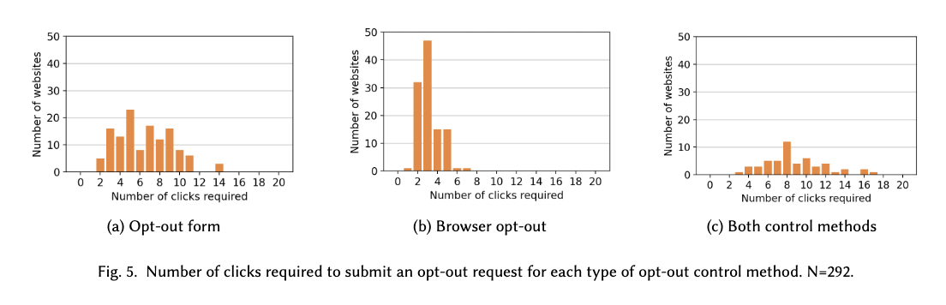
Number Of Clicks
Notes:
Specifically, we

Slide 54
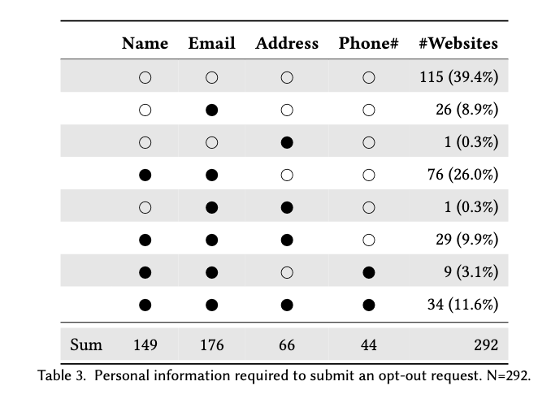
Personal Information Required

Slide 55
Do Opt-Out Processes Violate Ccpa Requirements?
Malfunctioning opt-out page
Require offline opt-out steps
Instructions only
Require login
Incomplete
Likely violate CCPA
Require unavailable info
Advertising industry opt-out tool
Outstanding follow-up actions
May violate CCPA
Not violate CCPA
Ambiguous status

Slide 56
RQ3: What Types Of Dark Patterns Are Used In The Opt-Out Process?

Slide 57
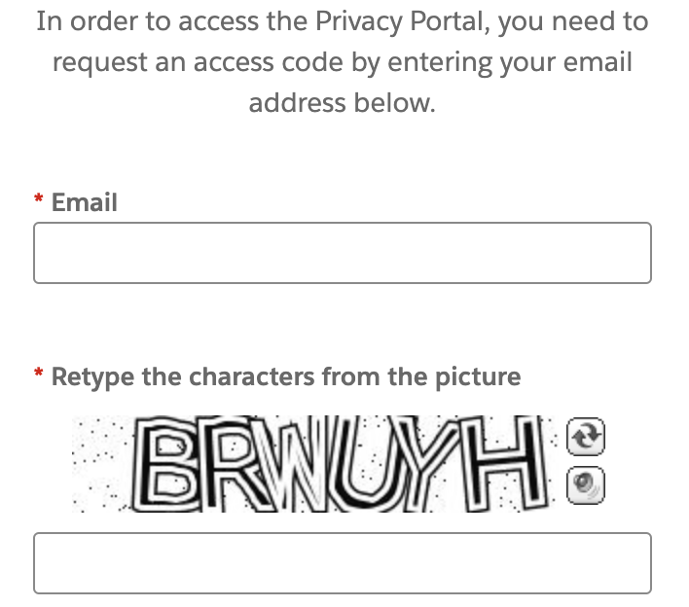
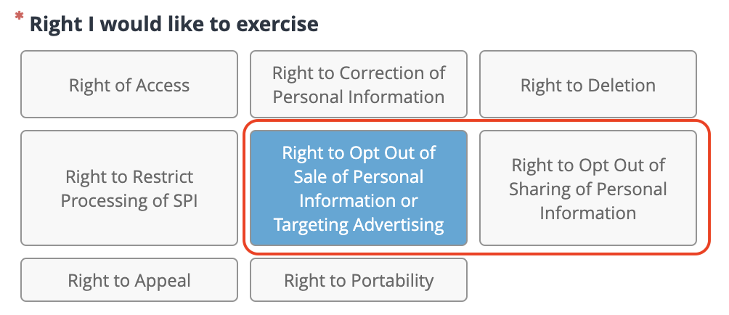
Obstruction
"Obstruction" refers to dark patterns where users encounter barriers or hurdles that make it difficult for them to complete a task or access information
Verified email message Users must solve a CAPTCHA and verify their identity via email to access a privacy portal. Website www.nfl.com.
Separate Submissions Users can only opt out of either
the sale or sharing of their personal information per
request—not both. Website www.finishline.com

Slide 58
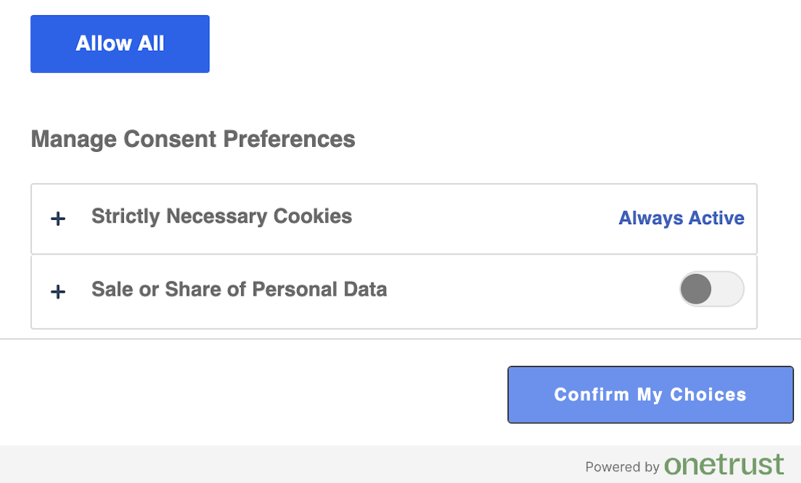
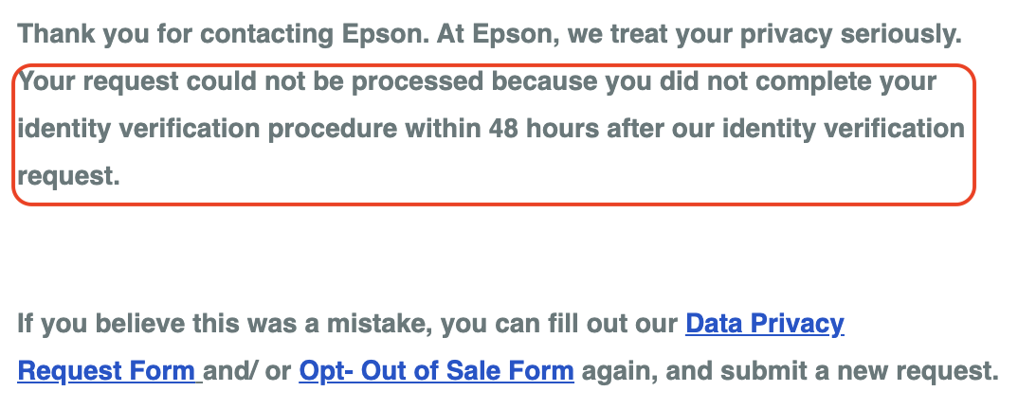
Obstruction
"Obstruction" refers to dark patterns where users encounter barriers or hurdles that make it difficult for them to complete a task or access information
Asymmetry It only takes one click for users to opt-in
(by clicking "Allow All") but it takes 2 clicks to opt-out
(toggle off and select "Confirm My Choices"). Website
www.huffpost.com.
Identity Confirmation Users must verify their identity
within a timeframe. If they fail, they have to resubmit
the request. Website https://epson.com/usa

Slide 59
Interface Interference
“Interface interference” is a strategy used to manipulate interfaces, privileging certain actions and, thus, limiting the discoverability of alternatives
Aesthetic manipulation The link to opt-out form is
difficult to see. Website https://theweek.com.

Slide 60
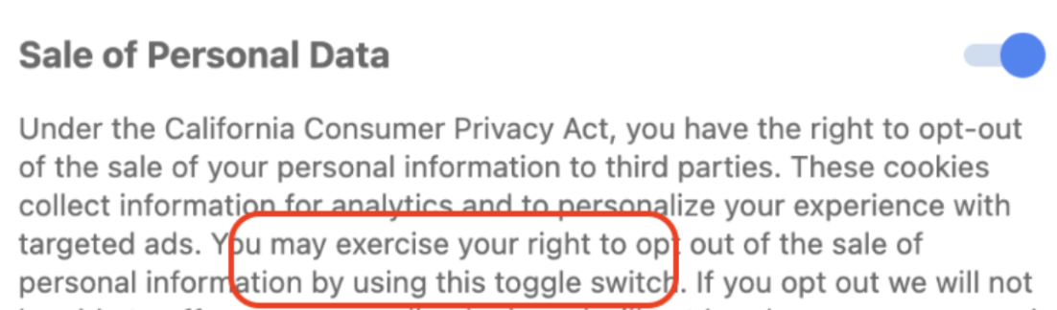
Misdirection
“Misdirection” refers to dark patterns where the instructions about how to exercise privacy-protective choices are either not mentioned or are very confusing.
Confusing Choices The users are instructed to "use this
toggle switch". However, neither the text nor the toggle
clearly indicates which direction should be toggled to.
Website www.apartmenttherapy.com.

Slide 61
RQ3: Are These Dark Patterns Violating CCPA Requirements Or Are They Exploiting The Loopholes That Have Not Been Addressed By The CCPA?

Slide 62
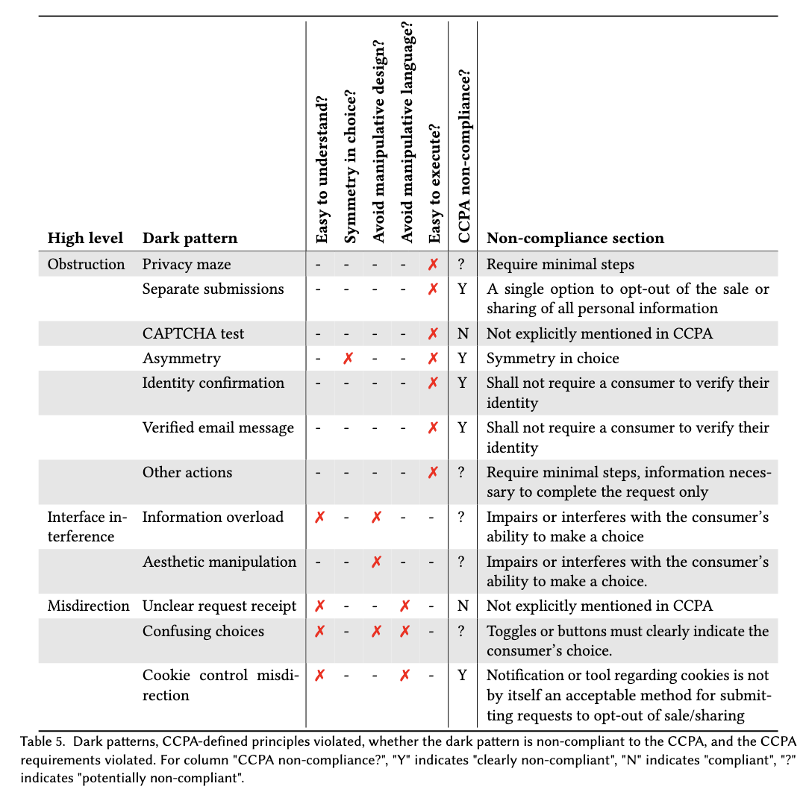

Slide 63
RQ4: What Are The Characteristics Of Websites That Employ Dark Patterns?

Slide 64
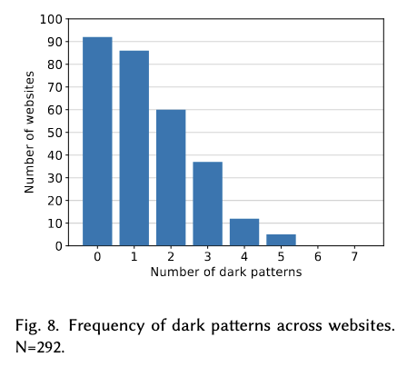
Prevalence Of Dark Patterns

Slide 65
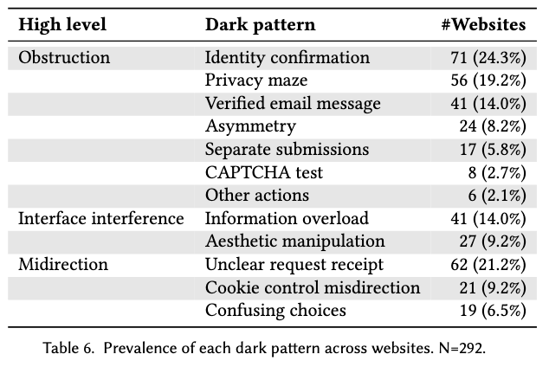
Prevalence Of Dark Patterns

Slide 66
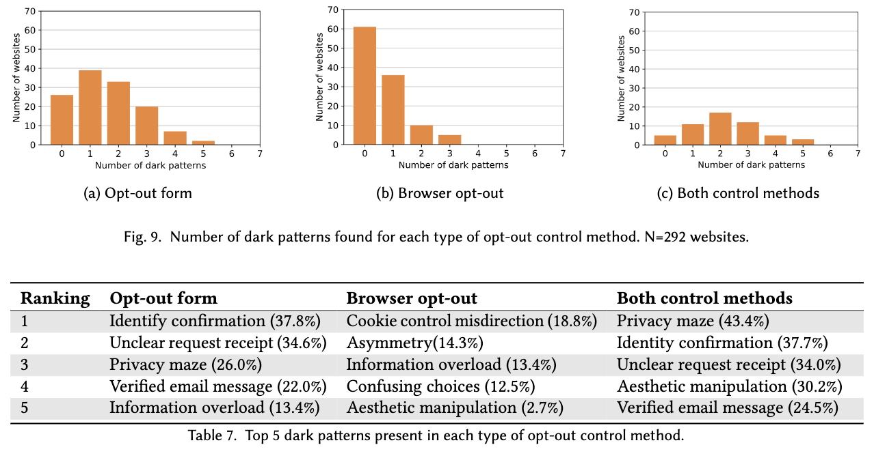
Distribution Of Dark Patterns Across Opt-Out Control Methods

Slide 67
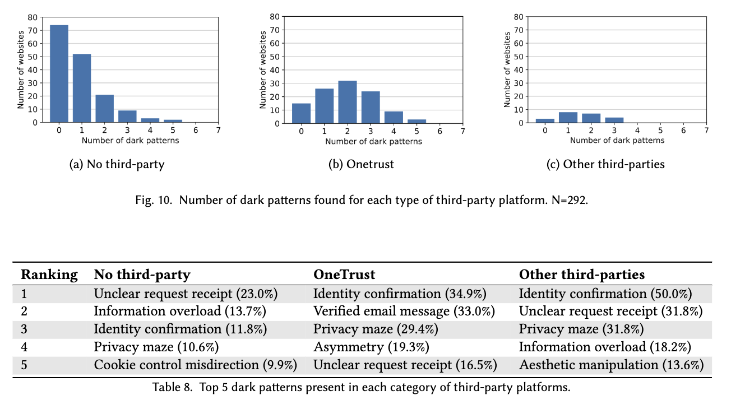
Distribution Of Dark Patterns Across Third-Party Platforms

Slide 68



Discussion
Effectiveness of the CCPA
Challenges of measuring CCPA non-compliance
Recommendations
Seems to improve since the CPRA went into effect
However, many websites still fail to comply with the CCPA
Regulators should take action to enforce the law
Policy makers need clearer guidelines and more specific requirements, should draft the law to make it easy to compliance check the website’ opt-out processes
Human-Intensive and Time Consuming to Examine Opt-Out Process.
Challenges of Defining a Dark Pattern.
Challenges of Verifying Whether Opt-Out Request Is Complied With and Fully Executed.

Slide 69
Conclusions
RQ1: Can consumers successfully exercise their opt-out rights?
What does it take for a consumer to submit an opt-out request? Do opt-out processes violate CCPA requirements?
What types of dark patterns are used in the opt-out process? (Section 5.2) Are these dark patterns violating CCPA requirements or are they exploiting the loopholes that have not been addressed by the CCPA?

Slide 70
Summary Of Findings
RQ1: Can consumers successfully exercise their opt-out rights?
RQ2: What does it take for a consumer to submit an opt-out request? Do opt-out processes violate CCPA requirements?
RQ3: What types of dark patterns are used in the opt-out process? Are these dark patterns violating CCPA requirements or are they exploiting the loopholes that have not been addressed by the CCPA?
RQ4: What are the characteristics of the websites that employ dark patterns?
Nearly 30% of the attempted opt-out requests could not be submitted, did not succeed, or had unclear status updates
The opt-out process varies widely depending on website categories, opt-out control methods, and third-party platforms handling the opt-out process on behalf of the websites. Some sites allow submission with just a few clicks, while others require a lengthy process and significant personal information.
Multiple types of dark patterns are found in the opt-out process. Although some dark patterns are clearly prohibited by the CCPA, others are not explicitly addressed by the CCPA.
Most websites implement at least one type of dark pattern. Sites with different opt-out control methods and third-party platforms tend to exhibit different types of dark patterns.

